Slide 1
Natural Language Processing Unit-2 Finite State Morphological Parsing (Day-11) 12-Feb-2019
By
B.K.Mishra

Slide 2
Today’s lecture
What are words? How many words are there?
What is the structure of words?
(in English, Hindi, Sanskrit, Chinese, Arabic,…)
Morphology: the area of linguistics that deals with this.
How can we identify the structure of words?
We need to build a morphological analyzer (parser).
We will use finite-state transducers for this task.
Finite-State Automata and Regular Languages

Slide 3
A Turkish word
uygarlaştıramadıklarımızdanmışsınızcasına
uygar_laş_tır_ama_dık_lar_ımız_dan_mış_sınız_casına
“as if you are among those whom we were not able to civilize (=cause to
become civilized)”
uygar: civilized
_laş: become
_tır: cause somebody to do something
_ama: not able
_dık: past participle
_lar: plural
_ımız: 1st person plural possessive (our)
_dan: among (ablative case)
_mış: past
_sınız: 2nd person plural (you)
_casına: as if (forms an adverb from a verb)
Sanskrit (Longest word from all language, 438 characters/letters size )
निरन्तरान्धकारित-दिगन्तर-कन्दलदमन्द-सुधारस-बिन्दु-सान्द्रतर-घनाघन-वृन्द-सन्देहकर-स्यन्दमान-मकरन्द-बिन्दु-बन्धुरतर-माकन्द-तरु-कुल-तल्प-कल्प-मृदुल-सिकता-जाल-जटिल-मूल-तल-मरुवक-मिलदलघु-लघु-लय-कलित-रमणीय-पानीय-शालिका-बालिका-करार-विन्द-गलन्तिका-गलदेला-लवङ्ग-पाटल-घनसार-कस्तूरिकातिसौरभ-मेदुर-लघुतर-मधुर-शीतलतर-सलिलधारा-निराकरिष्णु-तदीय-विमल-विलोचन-मयूख-रेखापसारित-पिपासायास-पथिक-लोकान्

Slide 4
Basic word classes (parts of speech)
Content words (open-class):
– Nouns: student, university, knowledge,...
– Verbs: write, learn, teach,...
– Adjectives: difficult, boring, hard, ....
– Adverbs: easily, repeatedly,...
Function words (closed-class):
– Prepositions: in, with, under,...
– Conjunctions: and, or,...
– Determiners: a, the, every,...

Slide 5
How many words are there?
The Unix command “wc -w” counts the words in a file.
> cat example.txt
This company isn't New York-based anymore
We moved to Chicago
> wc -w example.txt
10 example.txt
“wc -w” uses blanks to identify words:
This¹ company² isn't³ New⁴ York-based⁵ anymore⁶
We⁷ moved⁸ to⁹ Chicago¹⁰

Slide 6
Words aren’t just defined by blanks
Problem 1: Compounding
“ice cream”, “website”, “web site”, “New York-based”
Problem 2: Other writing systems have no blanks
Chinese: 我始小 我 始 小
I start(ed) writing novel(s)
Problem 3: Clitics
English: “doesn’t” , “I’m” ,
Italian: “dirglielo” = dir + gli(e) + lo
tell + him + it

Slide 7
How many words are there?
Of course he wants to take the advanced course too.
He already took two beginners’ courses.
This is a bad question. Did I mean:
How many word tokens are there?
(16 to 19, depending on how we count punctuation)
How many word types are there?
(i.e. How many different words are there?
Again, this depends on how you count, but it’s
usually much less than the number of tokens)

Slide 8
How many words are there?
Of course he wants to take the advanced course too.
He already took two beginners’ courses.
The same (underlying) word can take different forms:
course/courses, take/took
We distinguish concrete word forms (take, taking)
from abstract lemmas or dictionary forms (take)
Different words may be spelled/pronounced the same:
of course vs. advanced course
two vs. too

Slide 9
How many different words are there?
Inflection creates different forms of the same word:
Verbs: to be, being, I am, you are, he is, I was,
Nouns: one book, two books
Derivation creates different words from the same lemma:
grace ⇒ disgrace ⇒ disgraceful ⇒ disgracefully
Compounding combines two words into a new word:
cream ⇒ ice cream ⇒ ice cream cone ⇒ ice cream cone bakery
Word formation is productive:
New words are subject to all of these processes:
Google ⇒ Googler, to google, to ungoogle, to misgoogle, googlification, ungooglification, googlified, Google Maps, Google Maps service,...

Slide 10
Morphological Parsing
It is the process of determining the morphemes from which a given word is constructed. It must be able to distinguish between orthographic rules and morphological rules. For example, the word 'foxes' can be decomposed into 'fox' (the stem), and 'es' (a suffix indicating plurality).
The generally accepted approach to morphological parsing is through the use of a finite state transducer (FST), which inputs words and outputs their stem and modifiers. The FST is initially created through algorithmic parsing of some word source, such as a dictionary, complete with modifier markups.
Another approach is through the use of an indexed lookup method, which uses a constructed radix tree. This is not an often-taken route because it breaks down for morphologically complex languages.
Orthographic
Orthographic rules are general rules used when breaking a word into its stem and modifiers. An example would be: singular English words ending with -y, when pluralized, end with -ies. Contrast this to Morphological rules which contain corner cases to these general rules. Both of these types of rules are used to construct systems that can do morphological parsing.
Morphological
Morphological rules are exceptions to the orthographic rules used when breaking a word into its stem and modifiers. An example would be while one normally pluralizes a word in English by adding 's' as a suffix, the word 'fish' does not change when pluralized. Contrast this to orthographic rules which contain general rules. Both of these types of rules are used to construct systems that can do morphological parsing. Applications of morphological processing are machine translation, spell checker, information retrieval.

Slide 11
Inflectional morphology in English
Verbs:
– Infinitive/present tense: walk, go
– 3rd person singular present tense (s-form): walks, goes
– Simple past: walked, went
– Past participle (ed-form): walked, gone
– Present participle (ing-form): walking, going
Nouns:
– Number: singular (book) vs. plural (books)
– Plural: books
– Possessive (~ genitive case): book’s, books
– Personal pronouns inflect for person, number, gender, case:
I saw him; he saw me; you saw her; we saw them; they saw us.

Slide 12
Derivational morphology
Nominalization:
V + -ation: computerization
V+ -er: killer
Adj + -ness: fuzziness
Negation:
un-: undo, unseen, ...
mis-: mistake,...
Adjectivization:
V+ -able: doable
N + -al: national

Slide 13
Morphemes: stems, affixes
dis-grace-ful-ly
prefix-stem-suffix-suffix
Many word forms consist of a stem plus a number of
affixes (prefixes or suffixes)
Infixes are inserted inside the stem.
Circumfixes (German gesehen) surround the stem
Morphemes: the smallest (meaningful/grammatical)
parts of words.
Stems (grace) are often free morphemes.
Free morphemes can occur by themselves as words.
Affixes (dis-, -ful, -ly) are usually bound morphemes.
Bound morphemes have to combine with others to form words.

Slide 14
Morphemes and morphs
There are many irregular word forms:
– Plural nouns add -s to singular: book-books,
but: box-boxes, fly-flies, child-children
– Past tense verbs add -ed to infinitive: walk-walked,
but: like-liked, leap-leapt
Morphemes are abstract categories
Examples: plural morpheme, past tense morpheme
The same morpheme (e.g. for plural nouns) can be
realized as different surface forms (morphs):
-s/-es/-ren
Allomorphs: two different realizations (-s/-es/-ren)
of the same underlying morpheme (plural)

Slide 15
Morphological parsing
Disgracefully
dis grace ful ly
prefix stem suffix suffix
NEG grace+N +ADJ +ADV

Slide 16
Finite-State Automata and Regular Languages
Formal languages
An alphabet Σ is a set of symbols:
e.g. Σ= {a, b, c}
A string ω is a sequence of symbols, e.g ω=abcb.
The empty string ε consists of zero symbols.
The Kleene closure Σ* (‘sigma star’) is the (infinite)
set of all strings that can be formed from Σ:
Σ*= {ε, a, b, c, aa, ab, ba, aaa, ...}
A language L⊆ Σ* over Σ is also a set of strings.
Typically we only care about proper subsets of Σ* (L ⊂ Σ).

Slide 17
Automata and languages
An automaton is an abstract model of a computer which reads an input string, and changes its internal state depending on the current input symbol.
It can either accept or reject the input string.
Every automaton defines a language
(the set of strings it accepts).
Different automata define different language classes:
- Finite-state automata define regular languages
- Pushdown automata define context-free languages
- Turing machines define recursively enumerable languages

Slide 18
Finite State Automata (FSAs)
A finite-state automaton M =〈Q, Σ, q0, F, δ〉 consists of: A finite set of states Q = {q0, q1,.., qn}
- A finite alphabet Σ of input symbols (e.g. Σ = {a, b, c,...})
A designated start state q0 ∈ Q
- A set of final states F ⊆Q
- A transition function δ:
- The transition function for a deterministic (D)FSA: Q x Σ → Q
δ(q,w) = q’ for q, q’ ∈ Q, w ∈ Σ
If the current state is q and the current input is w, go to q’
- The transition function for a nondeterministic (N)FSA: Q x Σ → 2Q
δ(q,w) = Q’ for q ∈ Q, Q’ ⊆ Q, w ∈ Σ
If the current state is q and the current input is w, go to any q’ ∈ Q’

Slide 19
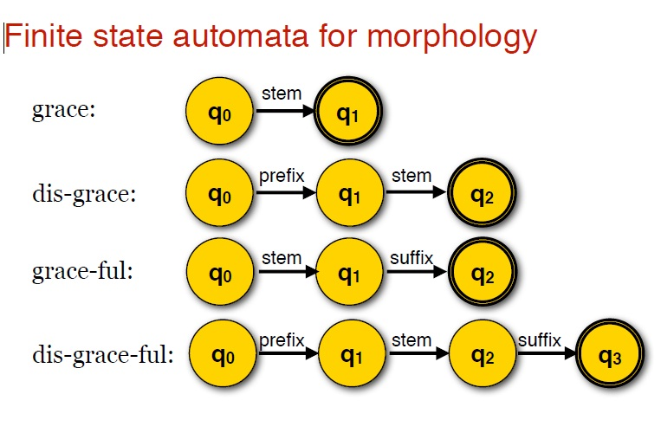

Slide 20
